Slide 1

Tools for scaling R using Azure
John-Mark Agosta, Vanja Paunić and Barbara Stortz
Microsoft
Acknowledgements: Ali-Kazim Zaidi, Microsoft
TUTORIAL MATERIAL & SLIDES:
1

Slide 2
Key learning objectives
How to scale R code with distributed, parallel processing
How to develop scalable E2E R data-science process
How to easily operationalize code and models written in R
How to use cloud infrastructure (single node or clusters) to develop, scale, operationalize
2

Slide 3
Tutorial Outline
Introduction [40 mins]
R language
IDEs for R
Libraries most used
R in the Cloud [50 mins]
Spark
Azure Batch
Remote execution (mrsdeploy)
R operationalization [50 mins]
Azure ML
R Server with SQL Server
mrsdeploy
short break after each section ~ 5-10 mins
3

Slide 4
Introduction
R language
IDEs for R
Libraries most used
Presenter
4

Slide 5
Introduction
What is R?
What limits the scalability of R scripts?
What functions and techniques can be used to overcome those limits?
5

Slide 6

Language
Platform
What is
The most popular statistical programming language
A data visualization tool
Open source
2.5+M users
Community
Taught in most universities
Many common use cases across industry
Thriving user groups worldwide
5th in 2016 IEEE Spectrum rank
42% pro analysts prefer R (highest amongst R, SAS, python)
Ecosystem
10,000+ contributed packages
Rich application & platform integration
6

Slide 7
R IDEs
R Studio
R Tools for Visual Studio
Jupyter notebooks
Command line
7

Slide 8
Popular libraries
8

Slide 9






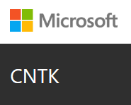


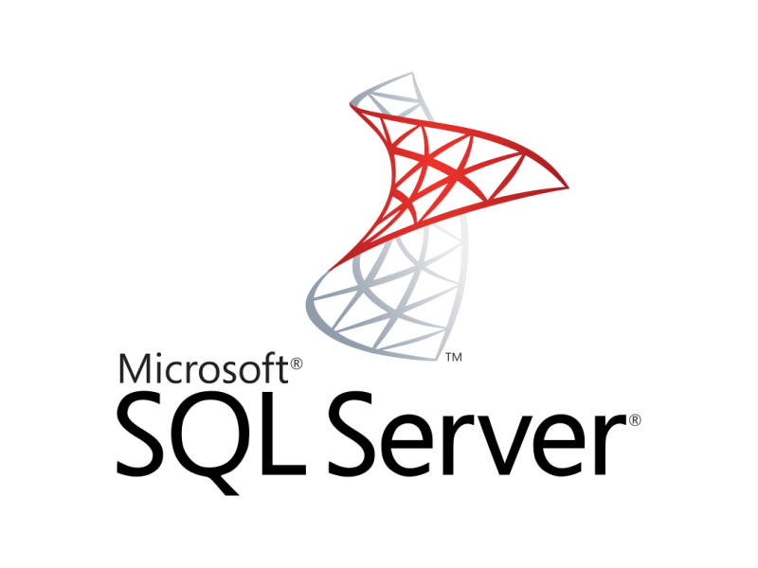



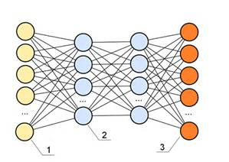





Single node Azure Linux DSVM w/ Spark (for Hands-On)
Data-science virtual machine
Vowpal Wabbit
xgboost
Rattle
Spark 2.0.2
HDFS (local)
Yarn
Developer edition
CNTK
http://aka.ms/dsvm
9

Slide 10
GitHub repository for all code and scripts
[insert link]
10

Slide 11
Hands on
Intro to R
Presenter
11

Slide 12
R in the Cloud
Spark
Azure Batch
Remote execution (mrsdeploy)
Presenter
12

Slide 13
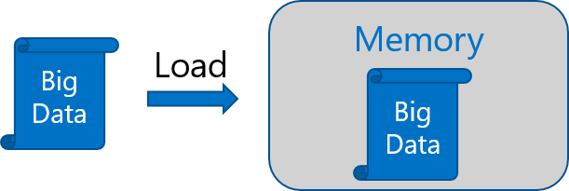
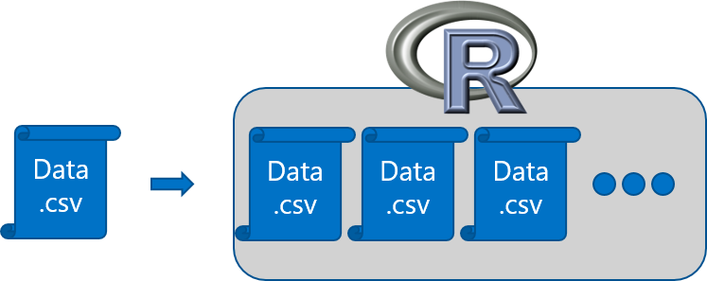
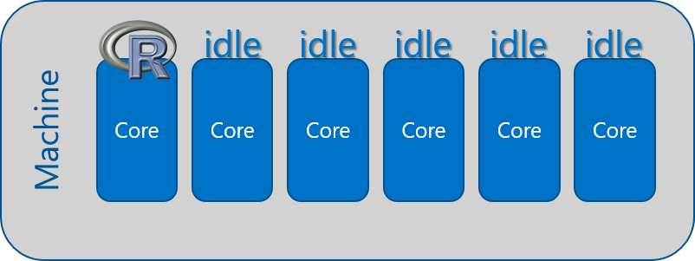
R adoption is on a Tear But there are several issues regarding scalability
In-Memory Operation
Expensive Data Movement
& Duplication
Lack of Parallelism
13

Slide 14
Couple of scalable R solutions
R packages for distributed computing
SparkR
sparklyr
RevoScaleR (Microsoft R Server)
h2o
and more!
14

Slide 15
Spark
15

Slide 16
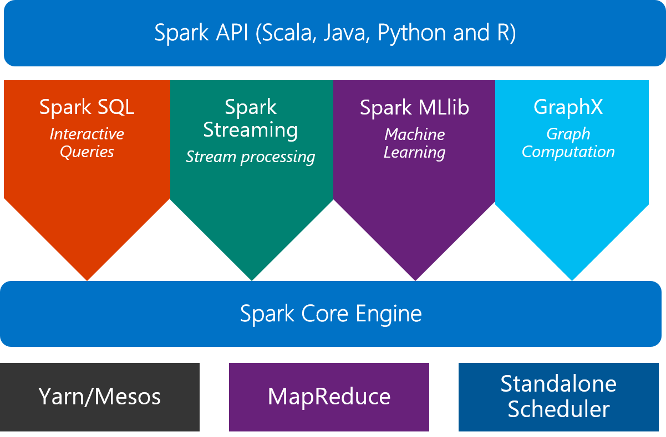
Scale on Spark clusters
What is Spark?
An unified, open source, parallel, data processing framework for Big Data Analytics
16

Slide 17

SparkR 2.0: a Spark API
An R package provides a light-weight frontend to use Apache Spark from R and allows data scientists to analyze large datasets.
SparkDataFrame is distributed collection of data organized into named columns.
SparkR can create SparkDataFrames from local R data frames, csv, json and parquet files.
With Hive support, it can also access tables from Hive MetaStore.
Pre-configured on Spark clusters in Azure HDInsight.
17

Slide 18
Data processing and modeling with SparkR
Supports functions for structured data processing:
Selections: select(), filter()
Grouping, Aggregations: summarize(), arrange()
Running local R functions distributed: spark.lapply()
Applying UDFs on each partition/group of a SparkDataFrame: dapply(), dapplyCollect(), gapply(), gapplyCollect()
Uses MLlib to train models and allows model persistence.
Generalized Linear Model
Survival regression
Naive Bayes
KMeans
Logistic Regression
Gradient Boosted Tree
Random Forest
… others
18

Slide 19
General analytical workflow in Spark
(across multiple toolkits)
Ingest into Spark DF
Wrangling and cleanup (Spark SQL, dplyr)
Creation of ML models in Spark
+
Model evaluation
Exploration and visualization
(for visualization, sampled data may need to be converted to R dataframe)
Transfor-mation and Featurization
(in Spark SQL or featurization functions)
Save models for deployment
Spark dataframes used multiple times in the workflow should be cached in memory
19

Slide 20
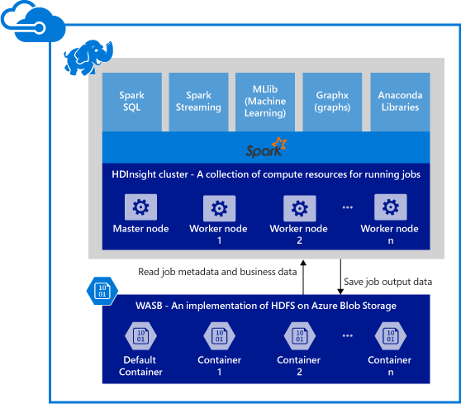
Spark clusters in Azure HDInsight
Provisions Azure compute resources with Spark 2.0.2 installed and configured.
Supports multiple versions (e.g. Spark 1.6).
Stores data in Azure Blob storage (WASB), Azure Data Lake Store or Local HDFS.
20

Slide 21
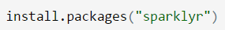
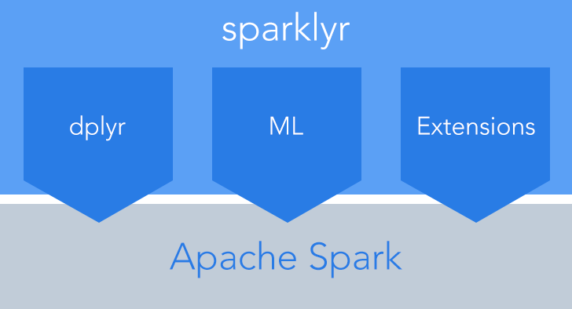
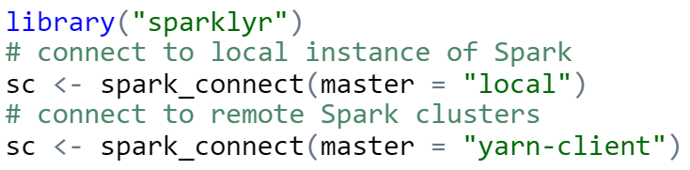
sparklyr: R interface for Apache Spark
Easy installation from CRAN
Connect to both local instances of Spark and remote Spark clusters
Loads data into SparkDataFrame from: local R data frames, Hive tables, CSV, JSON, and Parquet files.
Source: http://spark.rstudio.com/
21

Slide 22
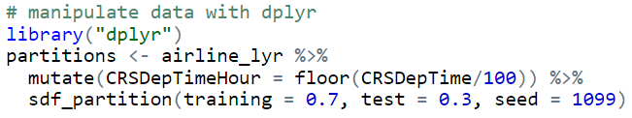
dplyr and ML in sparklyr
Provides a complete dplyr backend for data manipulation, analysis and visualization
%>%
Includes 3 family of functions for machine learning pipeline
ml_*: Machine learning algorithms for analyzing data provided by the spark.ml package.
K-Means, GLM, LR, Survival Regression, DT, RF, GBT, PCA, Naive-Bayes, Multilayer Perceptron, LDA
ft_*: Feature transformers for manipulating individual features.
sdf_*: Functions for manipulating SparkDataFrames.
22

Slide 23
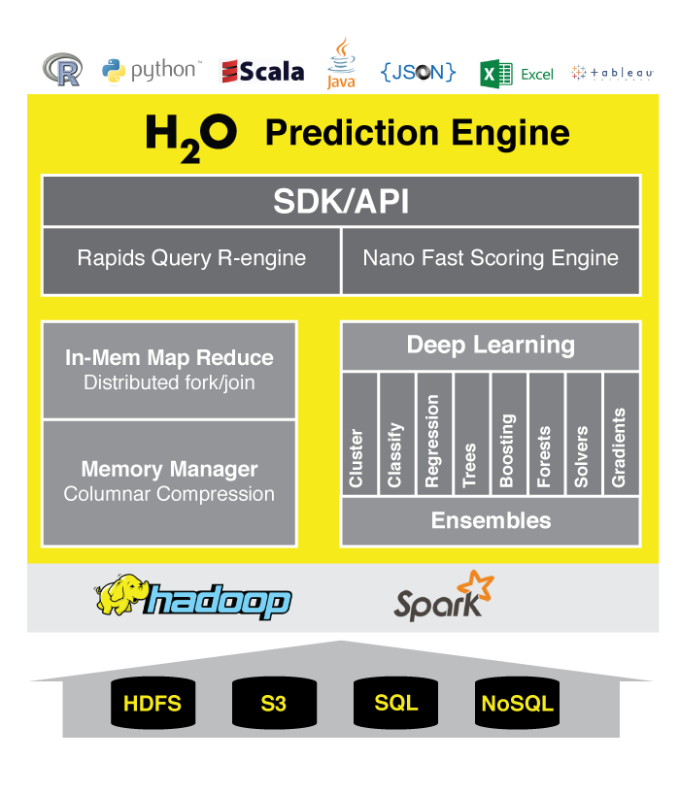
h2o: prediction engine in R
Optimized for “in memory” processing of distributed, parallel machine learning algorithms on clusters.
Data manipulation and modeling on H2OFrame: R functions + h2o pre-fixed functions.
Transformations: h2o.group_by(), h2o.impute()
Statistics: h2o.summary(), h2o.quantile(), h2o.mean()
Algorithms: h2o.glm(), h2o.naiveBayes(), h2o.deeplearning(), h2o.kmeans()
rsparkling package: h2o on Spark
Provides bindings to h2o’s machine learning algorithms
Simple data conversion: SparkDataFrame -> H2OFrame
http://www.h2o.ai/product/
23

Slide 24
R Server 9.0: scale-out R, Enterprise Class!
100% compatible with open source R
Any code/package that works today with R will work in R Server.
Ability to parallelize any R function
Ideal for parameter sweeps, simulation, scoring.
Wide range of scalable and distributed rx pre-fixed functions in RevoScaleR package.
Transformations: rxDataStep()
Statistics: rxSummary(), rxQuantile(), rxChiSquaredTest(), rxCrossTabs()…
Algorithms: rxLinMod(), rxLogit(), rxKmeans(), rxBTrees(), rxDForest()…
Parallelism: rxSetComputeContext()
24

Slide 25

Azure HDInsight + R Server: Managed Hadoop for Advanced Analytics in the Cloud
R
Easy setup, elastic, SLA
Ubuntu Linux
Cloud Storage
Spark
R Server
Leverage R skills with massively scalable algorithms and statistical functions
Reuse existing R functions over multiple machines
SparkR functions
RevoScaleR functions
Spark and Hadoop
Blob Storage
Data Lake Storage

Slide 26


R Server Hadoop Architecture
1. R Server Local Processing:
Data in Distributed Storage
R process on Edge Node
Data Scientists
Edge Node
Data Nodes
R
R
R
R
R
Head Nodes
2. R Server Distributed Processing:
Master R process on Edge Node
Apache YARN and Spark
Worker R processes on Data Nodes
R
R
R
R
R
R Server

Slide 27
Base and scalable approaches comparison
Approach | Scalability | Spark | Hadoop | SQL Server | Teradata | Support
CRAN R1 | Single machines |  |  |  |  | Community
SparkR | Single + Distributed computing | X |  |  |  | Community
sparklyr | Single + Distributed computing | X |  |  |  | Community
h2o | Single + Distributed computing | X | X |  |  | Community
RevoScaleR | Single + Distributed computing | X | X | X | X | Enterprise
CRAN R indicates no additional R packages installed
27

Slide 28
Remote execution - mrsdeploy
28

Slide 29
Azure Batch
29

Slide 30
Hands on: SparkR and R Server
Airline delay prediction demo
Presenter
30

Slide 31
Typical advanced analytics lifecycle
Prepare: Assemble, cleanse, profile and transform diverse data relevant to the subject.
Model: Use statistical and machine learning algorithms to build classifiers and regression models
Operationalize: Make predictions and visualizations to support business applications
Prepare
Model
Operationalize

Slide 32
Airline Arrival Delay Prediction Demo
Clean/Join – Using SparkR from R Server
Train/Score/Evaluate – Scalable R Server functions
Deploy/Consume – Using mrsdeploy from R Server

Slide 33
Airline data set
Passenger flight on-time performance data from the US Department of Transportation’s TranStats data collection
>20 years of data
300+ Airports
Every carrier, every commercial flight
http://www.transtats.bts.gov

Slide 34
Weather data set
Hourly land-based weather observations from NOAA
> 2,000 weather stations
http://www.ncdc.noaa.gov/orders/qclcd/

Slide 35
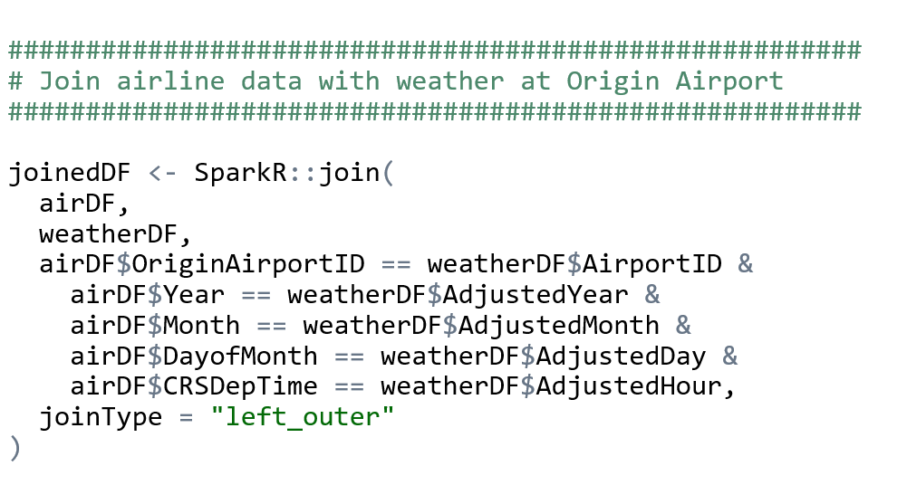
Clean and Join using SparkR in R Server

Slide 36
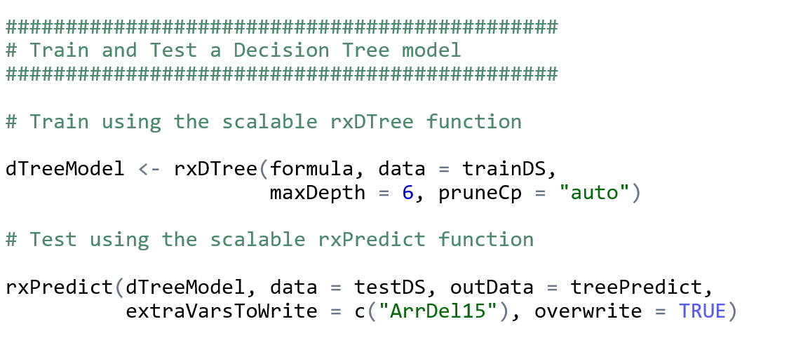
Train, Score, and Evaluate using R Server

Slide 37
R operationalization
Azure ML
R Server with SQL Server
mrsdeploy
Presenter
37

Slide 38
Azure ML
38

Slide 39
SQL Server R Services
39

Slide 40


Microsoft R Server: mrsdeploy
Easy Consumption
Explore and consume services in R directly
Data Scientist
Easy Deployment
Turn R into web services in one line of code
Microsoft R Client
(mrsdeploy package)
Data Scientist
Services / Sessions
getService
Microsoft R Client
(mrsdeploy package)
publishService
Microsoft R Server
configured for
operationalizing R analytics
REST API calls
Easy Setup
In-cloud or on-prem
Adding nodes to scale
High availability & load balancing
Remote execution server
Apps
Easy Integration
Swagger-based APIs: easy to consume with any programming language
Developer
40

Slide 41

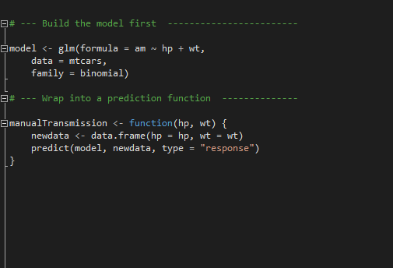
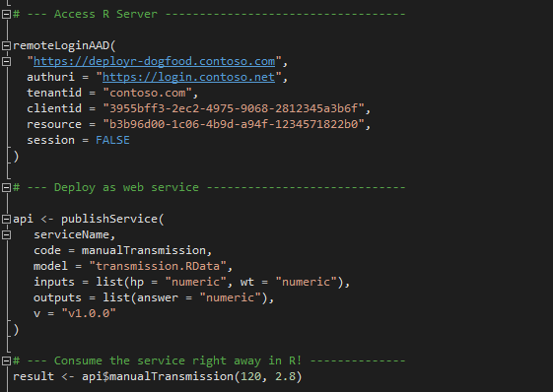
Deployment Turn R into Web Services easily; and consume them in R
Build the model first
Deploy as a web service instantly
Package: mrsdeploy
https://msdn.microsoft.com/en-us/microsoft-r/operationalize/configuration-initial
https://msdn.microsoft.com/en-us/microsoft-r/operationalize/admin-utility
41

Slide 42
Hands on: mrsdeploy
Airline delay prediction demo
Presenter
42

Slide 43
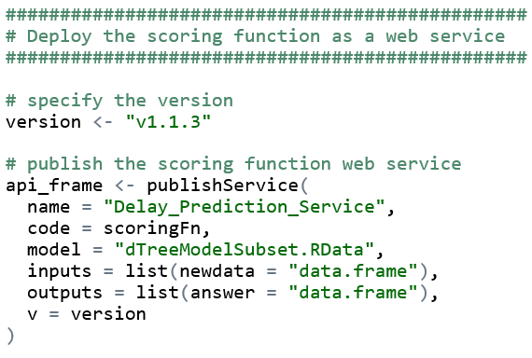
Publish Web Service from R

Slide 44
AzureML Hands on
44

Slide 45
Q & A
45

Slide 46
Extras
46

